Slide 1
CS2100 Tutorial 1
C and Number Systems
Slides by Theodore, adapted from Prof. Aaron’s slides

Slide 2
About myself
Theodore Leebrant
(Theodore/Theo is good!)
Computer Science + Mathematics
was a Programming Languages nerd, mostly with Rust
teaching CS3210 (Parallel Programming) as well this semester
Plays too much Final Fantasy XIV
Out-of-tutorial communication:
Email: theo@comp.nus.edu.sg for consults, questions
Telegram: next slide
Will reply messages within 24 hours – except 2 days before deadlines

Slide 3
Quick admin stuff
Telegram:
No groups for this semester sorry :(
I’m teaching 8 tutorial groups, so that’s gonna be a lot of telegram chats
If I combine all into 1 chat, that’s already ¼ of the cohort
Reachable via @kagamination on telegram
Slides will be uploaded here: https://github.com/theodoreleebrant/TA-2425S1
Anonymous feedback: bit.ly/feedback-theodore

Slide 4
CS2100 seen from the Burj Khalifa
Part 1: “Software”
Lowering C to assembly (MIPS) to machine code
C, MIPS, and a (prerequisite) of number systems
Part 2: “Hardware”
How does the processor work + how do we do digital logic design?
Datapath & Control, Boolean Alg, Logic Circuits, MSI Components, Sequential logic
Part 3:”Optimization”
Can we improve the simple computer that we learnt?
Cache, Pipelining
We’re going as low-level as it is in the CompSci syllabus.

Slide 5
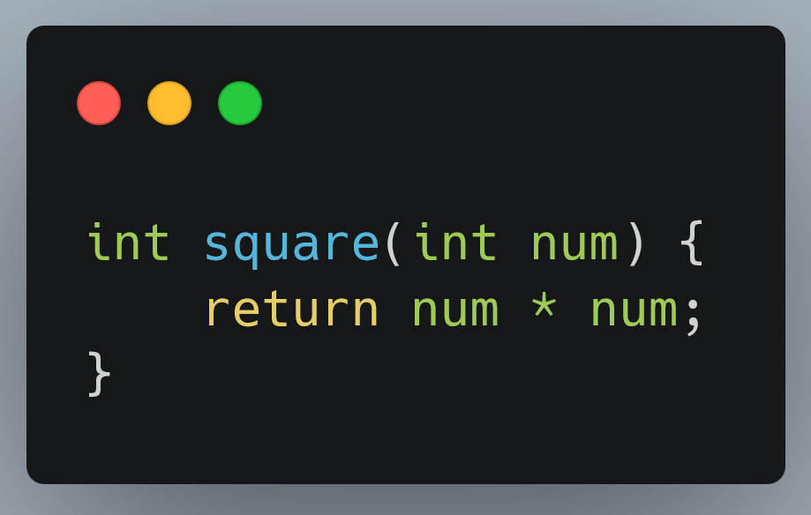
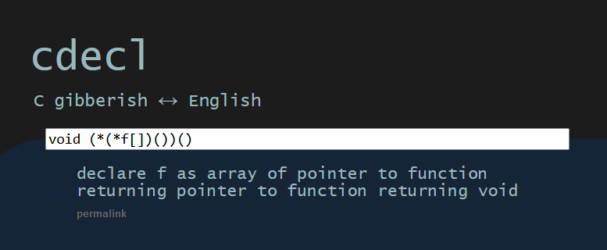
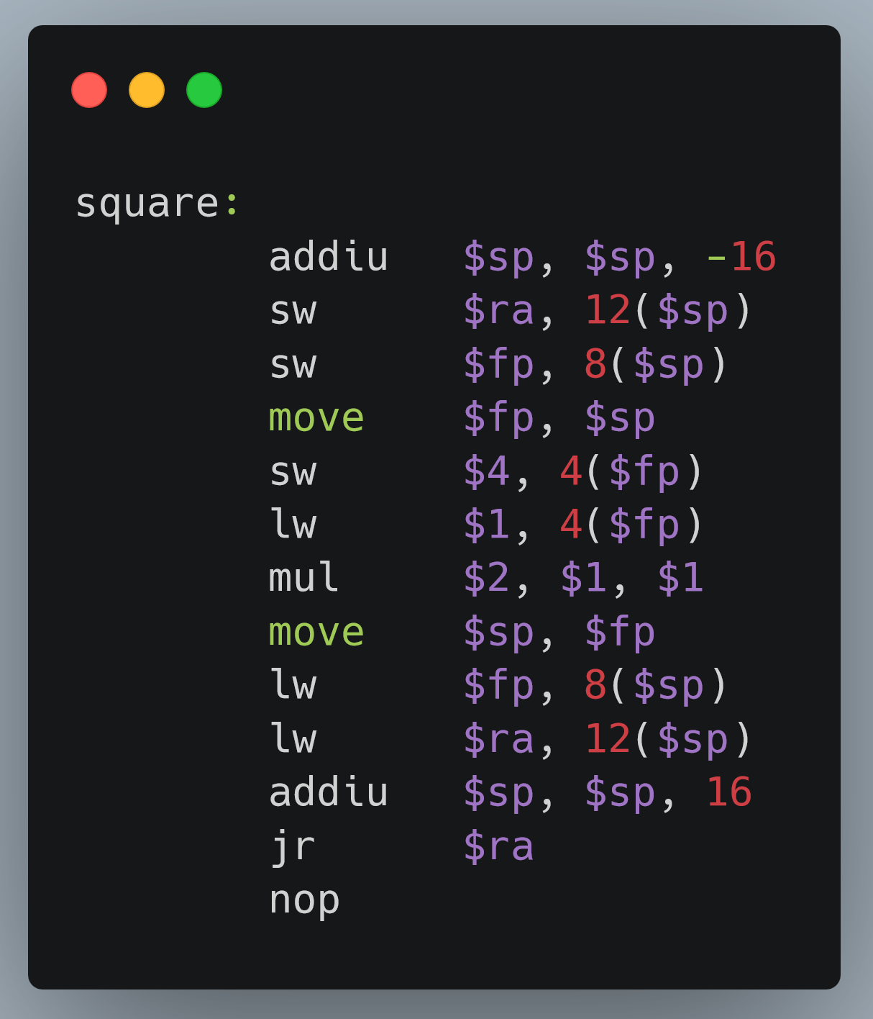
Our goals for the semester
(not just “finish the tutorials & labs” and “pass your exams”)
1. Get familiar with C and MIPS at the most basic level
You might not use it past CS2106, but it’s a good stepping stone to other languages
Credit: (left) cdecl.org/?q=void+(*(*f[])())()
(right) godbolt.org/ formatted with carbon.now.sh

Slide 6
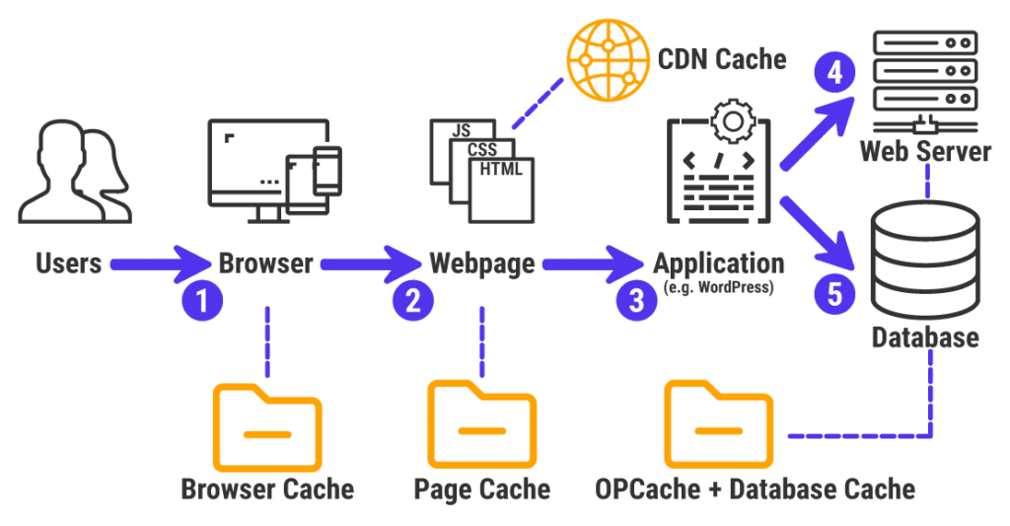
Our goals for the semester
(not just “finish the tutorials & labs” and “pass your exams”)
2. Be comfortable with optimization
This course gives you a small view of optimization in the narrow scope of processor optimization, but it is still applicable to a bunch of other scopes.

Slide 7
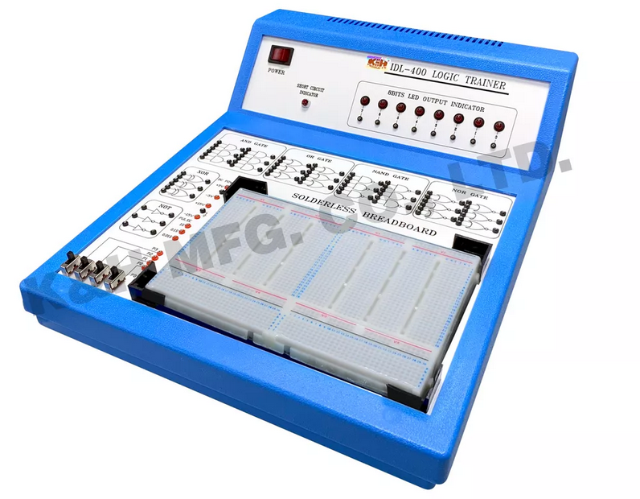
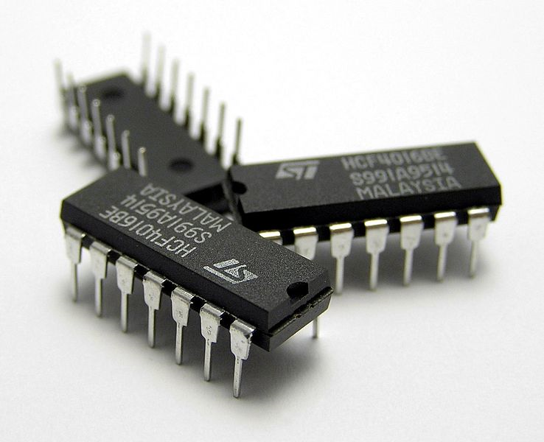
Our goals for the semester
(not just “finish the tutorials & labs” and “pass your exams”)
3. Have fun with hardware!
If you’re in CS, probably the first – and may be the last time you’re holding electrical components in an official course setting :)

Slide 8
Where do we go past CS2100?
There’s a bunch of transferrable knowledge / skills from CS2100
CS2106 Operating Systems
continued on CS5250 Advanced OS
or CS4223 Multi-Core Architecture
CS4212 Compilers
Any other modules that requires you to write in C
and C++, to a smaller extent
Any other modules / internships that requires you to write assembly
anything microprocessors definitely, some IoT things

Slide 9
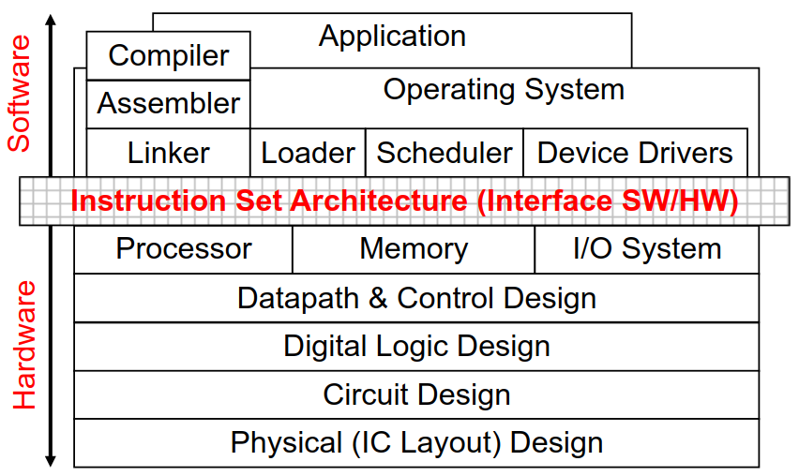
No such thing as stupid questions: ever
“Systems” are made up of many, many parts
Infinite learning process
Please feel free to bring anything up
Personal promise: all questions will be treated equally

Slide 10
General Tutorial Workflow
Try to do the questions beforehand!
If you don’t want to do the questions beforehand, at the very least read the questions so you’re not completely lost when I’m explaining
Short tutorial: only 1 hour
Will start at :05, and finish at :45
Feel free to leave for your next class if I overrun past this.
Attendance marked!
Any excused absences let me know via email (theo@comp.nus.edu.sg)

Slide 11
CS2100 Tutorial 01
C and Number Systems

Slide 12
Overview
Q1: Sign Extension
Q2: Subtraction in 1s complement
Q3: Fixed-point binary
Q4: IEEE754 single-precision representation (“floats”)
Q5: C basics – iteration, recursion, and arrays
Q6: C pointers

Slide 13
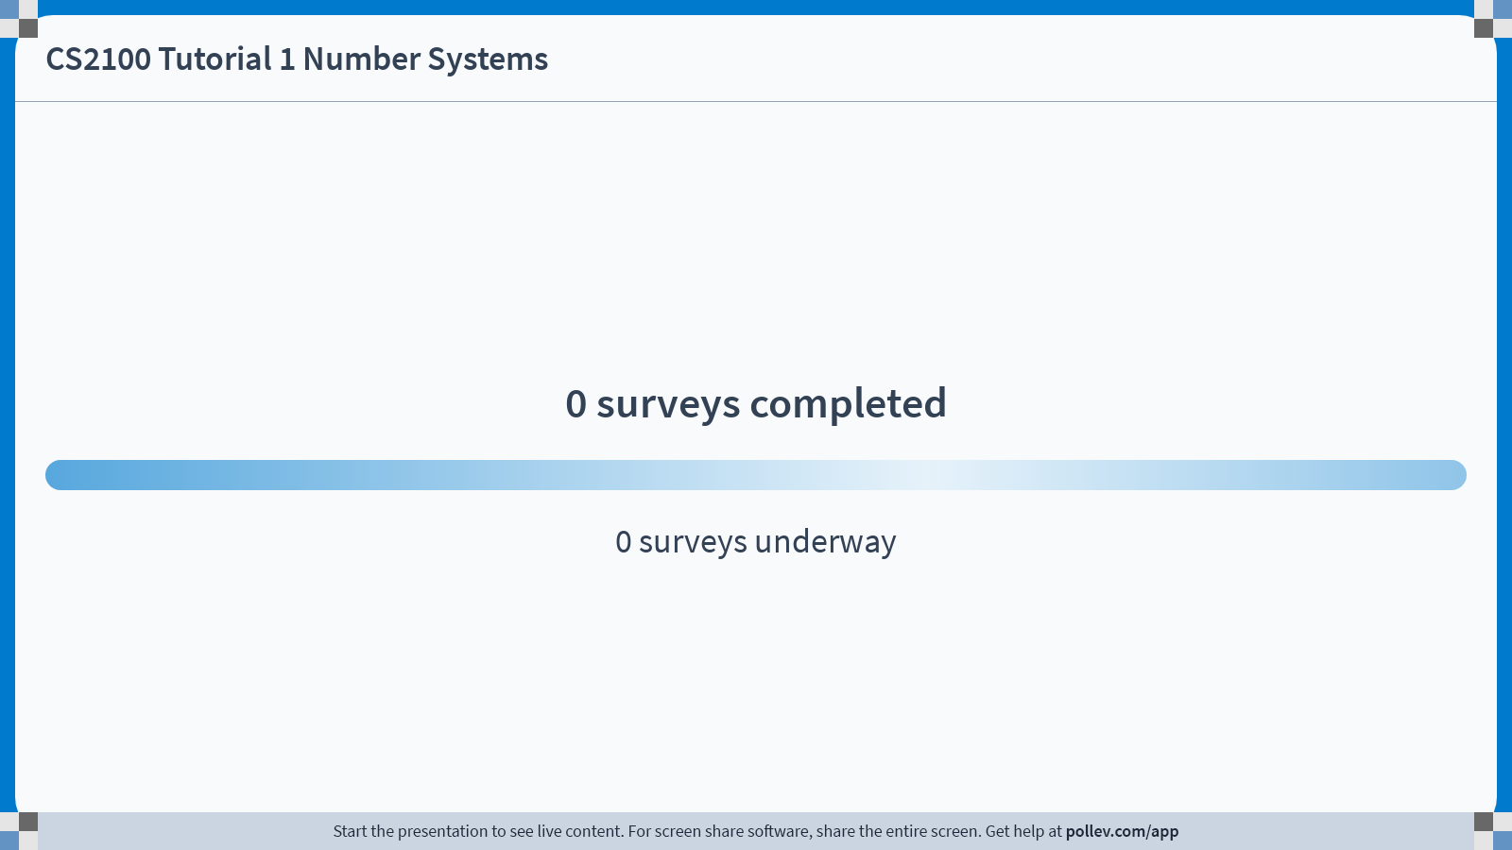
Notes:
Poll Title: Do not modify the notes in this section to avoid tampering with the Poll Everywhere activity. More info at polleverywhere.com/support CS2100 Tutorial 1 Number Systems https://www.polleverywhere.com/surveys/Ftj7T59516hSpGx6ZHgLq?display_state=chart&activity_state=opened&state=opened&flow=Engagement&onscreen=persist

Slide 14
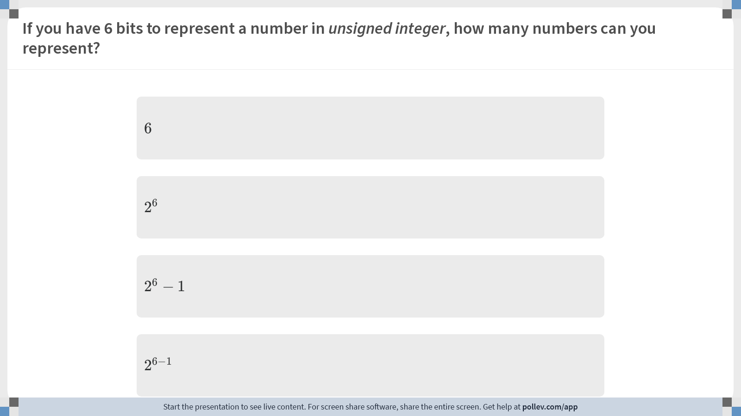
Notes:
Poll Title: Do not modify the notes in this section to avoid tampering with the Poll Everywhere activity. More info at polleverywhere.com/support If you have 6 bits to represent a number in unsigned integer, how many numbers can you represent? https://www.polleverywhere.com/multiple_choice_polls/euhEBtKapIwtIfEPCh6Gz?display_state=chart&activity_state=opened&state=opened&flow=Engagement&onscreen=persist&hide=instructions

Slide 15

Notes:
Poll Title: Do not modify the notes in this section to avoid tampering with the Poll Everywhere activity. More info at polleverywhere.com/support If you have 6 bits to represent a number in 1s complement, how many numbers can you represent? https://www.polleverywhere.com/multiple_choice_polls/wp6rHDU70XfkHMUAMqEzX?display_state=chart&activity_state=opened&state=opened&flow=Engagement&onscreen=persist&hide=instructions

Slide 16

Notes:
Poll Title: Do not modify the notes in this section to avoid tampering with the Poll Everywhere activity. More info at polleverywhere.com/support If you have 6 bits to represent a number in 2s complement, how many number can you represent? https://www.polleverywhere.com/multiple_choice_polls/nPie9wc8Afj76PTxH2Zdk?display_state=chart&activity_state=opened&state=opened&flow=Engagement&onscreen=persist&hide=instructions

Slide 17
Unsigned, 1s complement, 2s complement
Two ways of seeing n-bit 1’s complement:
If the MSB is 1, it’s negative. Flip the rest of the bits to get the number
The MSB has a value of –(2^{n-1} – 1), the rest goes as usual
Example: 4-bit 1’s complement
(1101)_{1s}

Slide 18
Unsigned, 1s complement, 2s complement
Two ways of seeing n-bit 2’s complement:
If the MSB is 1, it’s negative. Flip the rest of the bits and add 1 to get the number
The MSB has a value of –(2^{n-1}), the rest goes as usual
Example: 4-bit 2’s complement
(1101)_{2s}

Slide 19
Q1. Sign Extension
For complement systems, we can extend the sign bit if we increase the number of bits used for the representation
Example:
From 4 bits to 8 bits:
(5)₁₀ = (0101)_{2s} = (00000101)_{2s}
(-3)₁₀ = (1101)_{2s} = (11111101)_{2s}
Note: Sign extension works for complement systems – in binary, both 1s and 2s complement

Slide 20
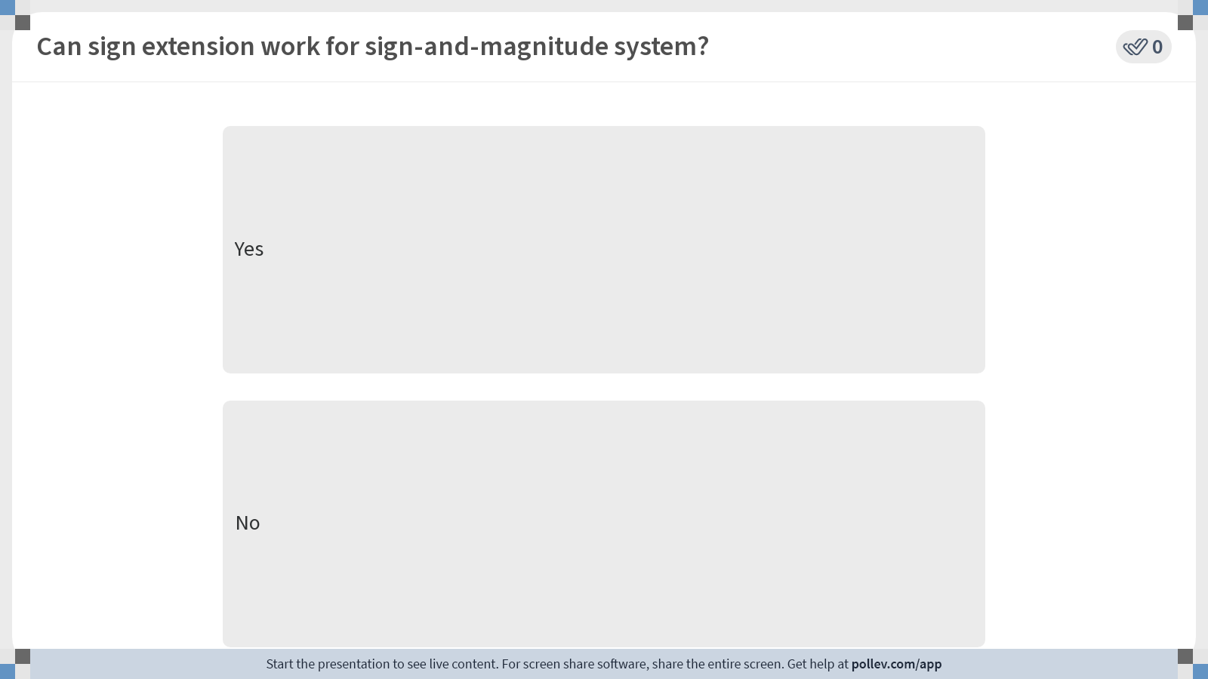
Notes:
Poll Title: Do not modify the notes in this section to avoid tampering with the Poll Everywhere activity. More info at polleverywhere.com/support Can sign extension work for sign-and-magnitude system? https://www.polleverywhere.com/multiple_choice_polls/X2XiBqmrpvIuzKHB8HyLz?display_state=instructions&activity_state=opened&state=opened&flow=Engagement&onscreen=persist

Slide 21
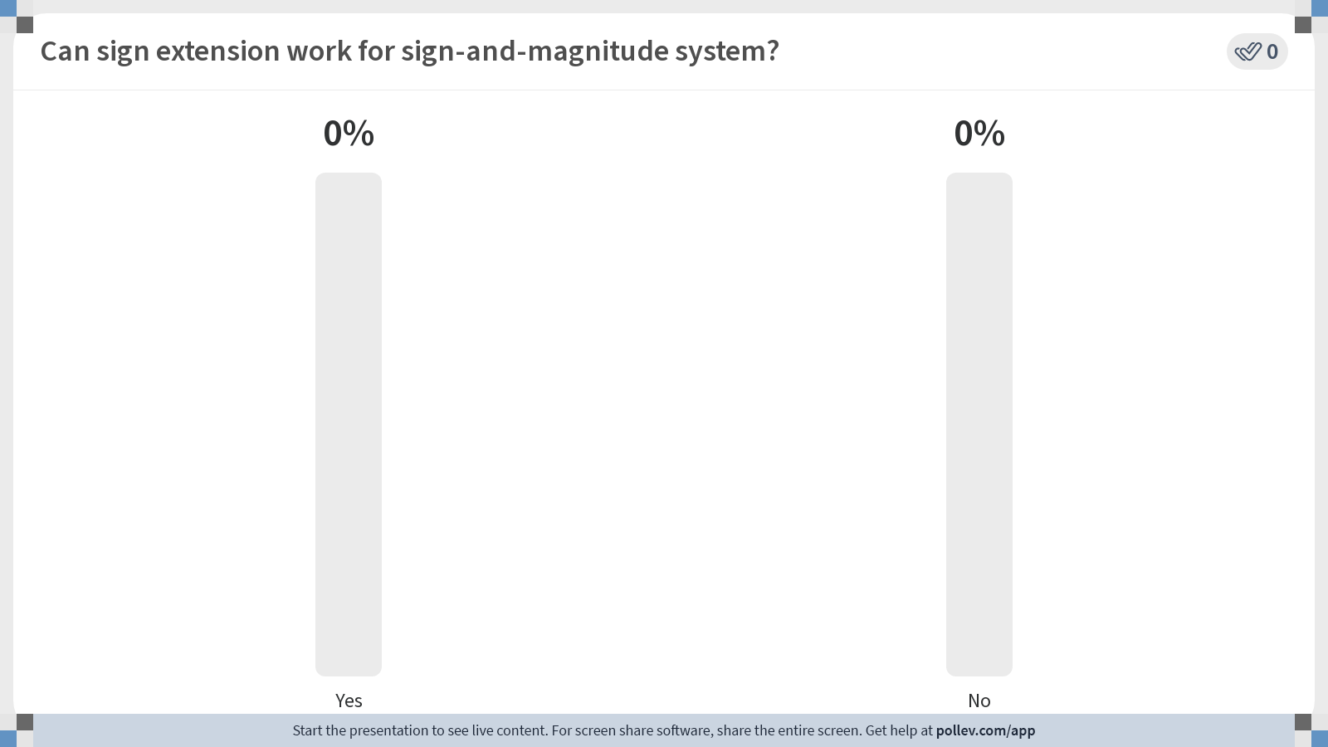
Notes:
Poll Title: Do not modify the notes in this section to avoid tampering with the Poll Everywhere activity. More info at polleverywhere.com/support Can sign extension work for sign-and-magnitude system? https://www.polleverywhere.com/multiple_choice_polls/X2XiBqmrpvIuzKHB8HyLz?display_state=chart&activity_state=opened&state=opened&flow=Engagement&onscreen=persist

Slide 22

Notes:
Poll Title: Do not modify the notes in this section to avoid tampering with the Poll Everywhere activity. More info at polleverywhere.com/support Can sign extension work for sign-and-magnitude system? https://www.polleverywhere.com/multiple_choice_polls/X2XiBqmrpvIuzKHB8HyLz?display_state=chart&activity_state=closed&state=closed&flow=Engagement&onscreen=persist

Slide 23
Q1. Sign Extension
Question: Show that sign extension does not change the value represented.
Answer:
Straightforward for positive values, since we pad zeroes
For negative numbers:
Reminder One way to see 2s complement is that the MSB has a value of –(2^{n-1}), the rest goes as usual
(-3)₁₀ = (1101)_{2s} = (11111101)_{2s}
Value: – 2⁷ + 2⁶ + 2⁵ + 2⁴ + 2³
= –128+64+32+16+8 = –8
Value: –2³ = –8

Slide 24
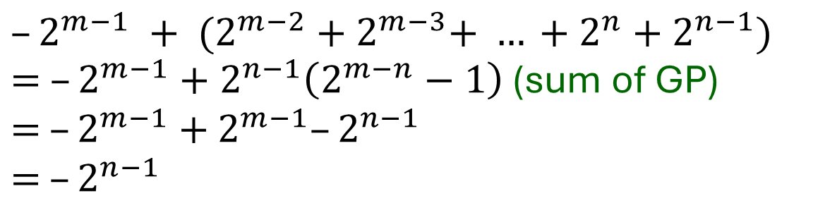

Q1. Sign Extension
Reminder One way to see 2s complement is that the MSB has a value of –(2^{n-1}), the rest goes as usual
For negative numbers:
In general,
(-3)₁₀ = (1101)_{2s} = (11111101)_{2s}
Value: – 2⁷ + 2⁶ + 2⁵ + 2⁴ + 2³
= –128+64+32+16+8 = –8
Value: –2³ = –8
$$–2^{n−1}$$
$$–2^{m−1} + {(2^{m−2}+2}^{m−3}+ … +2^{n}+2^{n−1})$$
$= –2^{m−1}+2^{n−1}\left(2^{m−n}−1\right)$ (sum of GP)
$=$ $–2^{m−1}+$ $2^{m−1}–2^{n−1}$
$=$ $–2^{n−1}$

Slide 25
Q2. Subtraction in 1s complement
Side note: Read the definition of (r-1)’s complement. Definition stands for more than just binary number systems.
0101.11 – 010.0101
010111.101 – 0111010.11
Strategy: Convert A - B to A + (-B)
Extra question: what if these numbers are in 2s complement?
Why do we not perform subtraction directly?
Note Adding trailing zeroes is not sign extension.

Slide 26
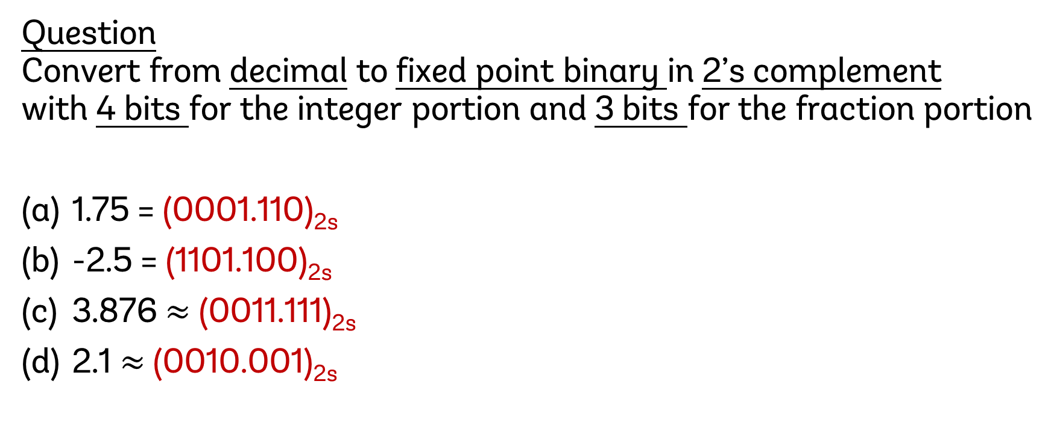
Q3. Decimal → Fixed point binary
Question Convert from decimal to fixed point binary in 2’s complement with 4 bits for the integer portion and 3 bits for the fraction portion
1.75 = (0001.110)_{2s}
-2.5 = (1101.100)_{2s}
3.876 $≈$ (0011.111)_{2s}
2.1 $≈$ (0010.001)_{2s}
Reminder: always do your conversion to one extra place and round accordingly

Slide 27
Q3. Decimal → Fixed point binary
Question Convert it back to decimal.
(0001.110)_{2s} = (0001.110)₂ = 2⁰ + 2⁻¹ + 2⁻² = 1.75
(1101.100)_{2s} = –(0010.100)₂ = –(2¹ + 2⁻¹) = –2.5
(0011.111)_{2s} = (0011.111)₂ = 2¹ + 2⁰ + 2⁻¹ + 2⁻² + 2⁻³ = 3.875
(0010.001)_{2s} = (0010.001)₂ = 2¹ + 2⁻³ = 2.125

Slide 28
Q4. IEEE754 single-precision repr.
Question
Represent -0.078125 in IEEE 754 single-precision representation.
Express your answer in hexadecimal.
Answer
First step is to convert to binary and write it in the normalized form
-0.078125 = -(0.000101)₂ = -( 1.01 )₂ × 2⁻⁴

Slide 29
Q4. IEEE754 single-precision repr.
Answer (cont.)
After we get the normalized form, convert it to binary repr.
- ( 1.01 )₂ × 2⁻⁴
Remember that exponent is in excess-127.
Exponent part is (-4 + 127)₁₀ = (123)₁₀ = (01111011)₂
1
01111011
01000000000000000000000
Sign-bit
8-bit exponent
23-bit mantissa

Slide 30
Q4. IEEE754 single-precision repr.
Answer (cont.)
Lastly, we convert into hexadecimal.
Group into four bits for easier conversion
1011 1101 1010 0000 0000 0000 0000 0000 B D A 0 0 0 0 0
Answer: (BDA0 0000)₁₆
1
01111011
01000000000000000000000
Sanity check: IEEE754 single-precision will always be 8 hexadecimal digits.

Slide 31
Q5. C basics: iteration, recursion, and arrays
Try on your own!
Let me know if you have difficulties.

Slide 32
Q6. C Pointers
Q: Trace the program and write out its output.
int a = 3, *b, c, *d, e, *f;
b = &a;
*b = 5;
c = *b * 3;
d = b;
e = *b + c;
*d = c + e;
f = &e;
a = *f + *b;
*f = *d - *b;

Slide 33
Summary
Number systems:
Integers: unsigned binary, 1s complement, 2s complement, sign-and-magnitude
Non-integers: fixed-point representation, IEEE754 single-precision representation
Sign extensions (vs. adding trailing zeroes)
C: iteration, recursion, array access / writes, pointers

Slide 34

End of Tutorial 1
Slides uploaded on github.com/theodoreleebrant/TA-2425S1
Email: theo@comp.nus.edu.sg
Anonymous feedback:
bit.ly/feedback-theodore
(or scan on the right)

